Slide 1
What does an object store?

Slide 2
Objects store addresses
(which are like URLs)

Slide 3
Primitives vs Objects
Primitives store their actual value in their variable box. You can compare values with == and !=, and the original does not change when passed as a parameter and changed.
Objects store their address in their variable box. You can’t compare properties of an object via ==, and the original does change when passed as a parameter and changed.
Primitives, when parameters, are passed by value, Objects are passed by their address.

Slide 4
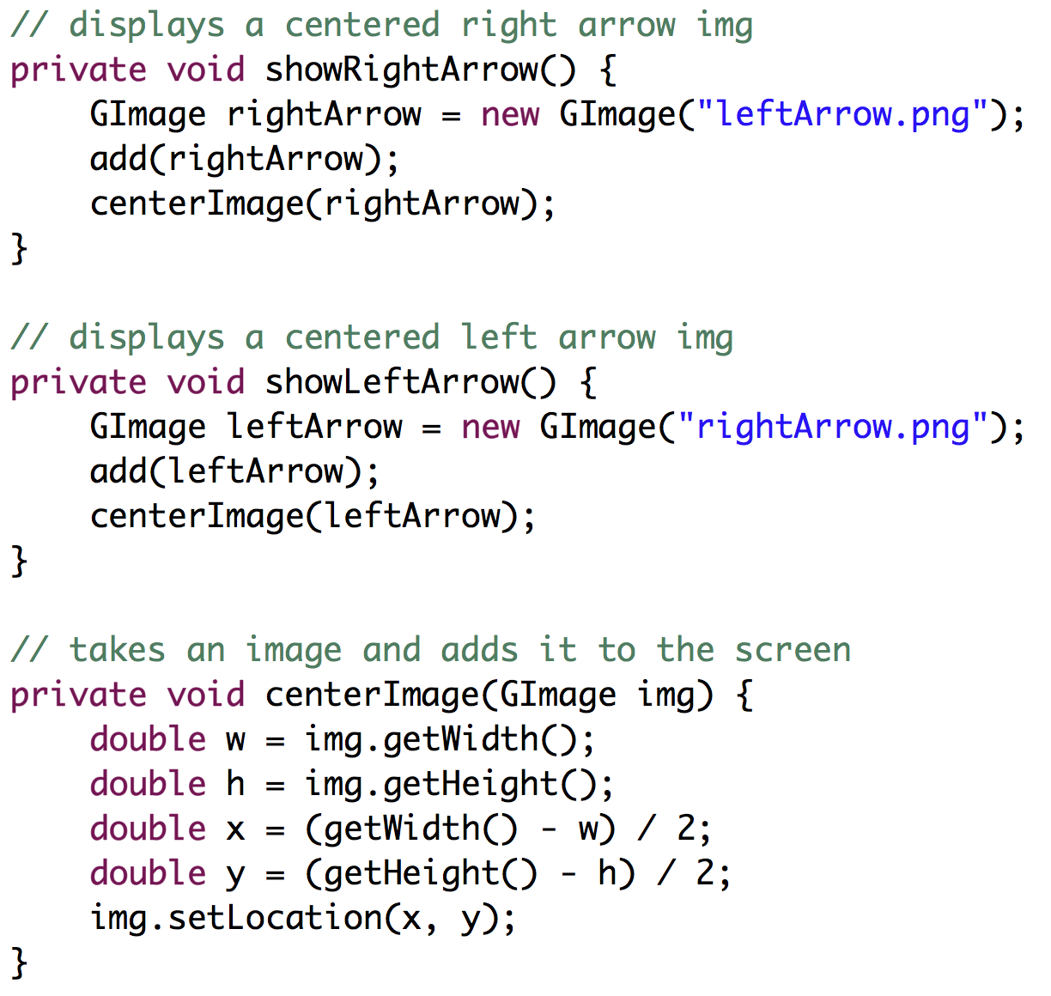
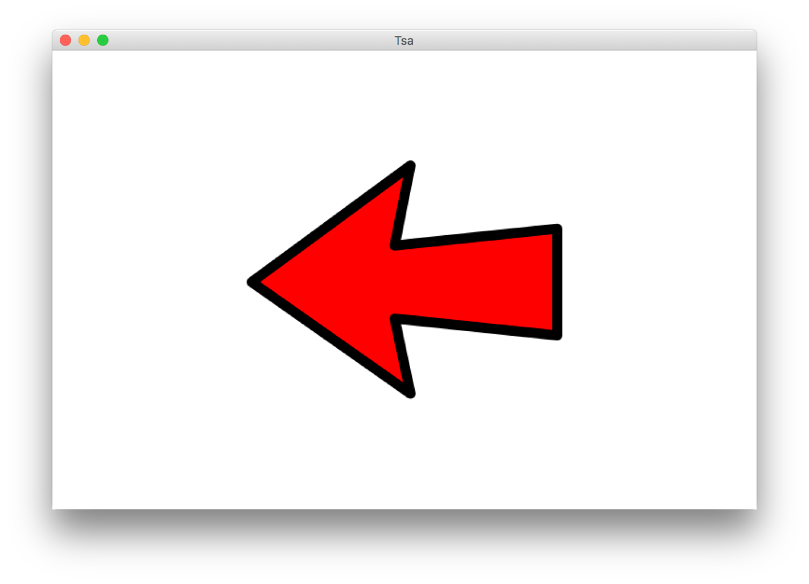
Revisit our Programs

Slide 5
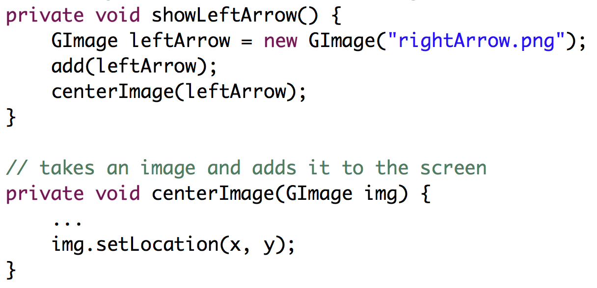
heap
28
run
showLeftArrow
leftArrow
28
e
l
l
o
centerImage
img
28
x = 0, y = 0

Slide 6
heap
28
run
showLeftArrow
leftArrow
28
e
l
l
o
centerImage
img
28
x = 327, y = 104

Slide 7

Fake Medicine was a Problem
700,000 deaths a year from fake malaria and tuberculosis drugs [1]
Equivalent of this many crashes per day
[1] http://www.un.org/africarenewal/magazine/may-2013/counterfeit-drugs-raise-africa%E2%80%99s-temperature

Slide 8

Chris’ Favorite Program
Bright Simons

Slide 9
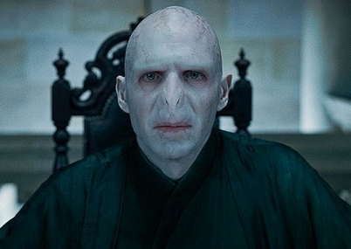
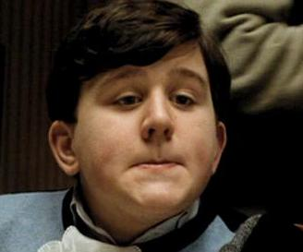

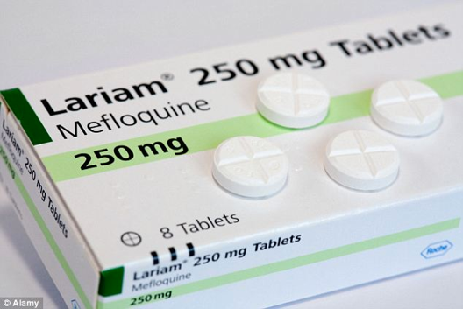
Underlying Puzzle
Counterfeiter
User
You (Distributor)

Slide 10
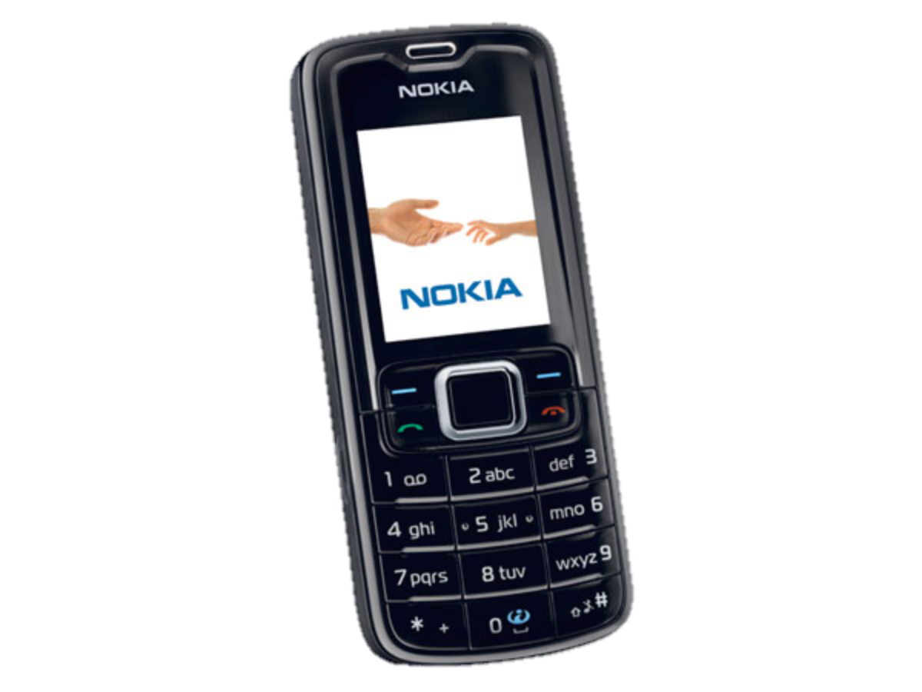
Underlying Puzzle
Counterfeiter
?
User
You (Distributor)

Slide 11
Revisit this on Wednesday

Slide 12

Text Processing
Chris Piech
CS106A, Stanford University

Slide 13


Learning Goals
Be able to perform math operations on chars
Be able to write string algorithms that loops over each character

Slide 14
Text Problem: Decryption
Joan Clarke
Alan Turing

Slide 15
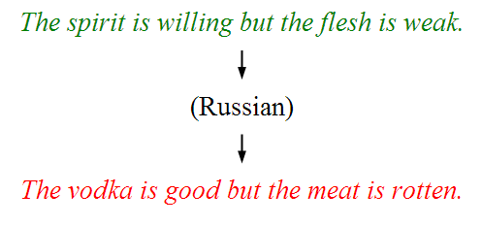
Text Problem: Translation
*This result cost billions of dollars (adjusted for inflation)

Slide 16
How is text
represented?

Slide 17
Text is stored using the variable type String.
A String is a sequence of characters.
The variable type String
public void run() {
String text = “hello!”;
println(text);
}
Notes:
Write code that reads in a line of text from the user and echoes it back. First, do “Nubian Ibex”

Slide 18
H
e
l
l
o
!
Notes:
Strings are made of characters.

Slide 19
H
e
l
l
o
!
0
1
2
3
4
5

Slide 20
How it is actually stored
public void run() {
String text = “hello!”;
}
stack
heap
run
28
text
28
Length: 6
H
e
l
l
o
!

Slide 21
H
e
l
l
o
!
0
1
2
3
4
5
text.charAt(index)

Slide 22
All characters in a string have an index.
You can access a character in the sequence via its index

Slide 23
Looping with Strings
Because each character in a string occupies a particular index, you can visit all the characters in a string one at a time using a loop.
Canonical “loop over the characters in a string” loop:
for (int i = 0; i < string.length(); i++) {
char ch = string.charAt(i);
/* … process ch … */
}
The string.length() method returns the number of characters in the string. This is one larger than the last valid index in the string.
H
i
m
o
m
(length 6)
0
1
2
3
4
5
Notes:
Review the ourPrintln method, which prints one character at a time.

Slide 24
numLs

Slide 25
How are characters
represented?

Slide 26
The variable type char
The primitive type char represents a single character or glyph.
Some examples:
char letterA = 'A';
char plus = '+'
char zero = '0';
char space = ' ';
char newLine = '\n'; // special
char first = text.charAt(0);

Slide 27
Enumeration
private static final int FROSH = 1;
private static final int SOPHOMORE = 2;
private static final int JUNIOR = 3;
private static final int SENIOR = 4;
private static final int OTHER = 5;
private int askForYear() {
while (true) {
int year = readInt("Enter class year: ");
if (year >= FROSH && year <= OTHER) return year;
}
}
private void printPopulation() {
for(int year = FROSH; year <= SENIOR; year++) {
printYear(year);
}
}

Slide 28
Chars are just a giant enumeration. You can use math operators on char!

Slide 29
ASCII
* This is only the first half of the table
The letter A, for example, has the ASCII value 65
Using portions of slides by Eric Roberts

Slide 30
‘A’ -> ‘Z’ are sequential.
‘a’ -> ‘z’ are sequential.
‘0’ -> ‘9’ are sequential.

Slide 31
toUpperCase

Slide 32
Useful Character methods
public void run() {
String str = readLine("Line: ");
char ch = str.charAt(0);
println("Original first char: " + ch);
ch = Character.toUpperCase(ch);
println("Uppercase first char: " + ch);
if(Character.isLetter(ch)) {
println("It’s a letter!");
}
}

Slide 33
Useful Character methods
static boolean isDigit(char ch)
Determines if the specified character is a digit.
static boolean isLetter(char ch)
Determines if the specified character is a letter.
static boolean isLetterOrDigit(char ch)
Determines if the specified character is a letter or a digit.
static boolean isLowerCase(char ch)
Determines if the specified character is a lowercase letter.
static boolean isUpperCase(char ch)
Determines if the specified character is an uppercase letter.
static boolean isWhitespace(char ch)
Determines if the specified character is whitespace (spaces and tabs).
static char toLowerCase(char ch)
Converts ch to its lowercase equivalent, if any. If not, ch is returned unchanged.
static char toUpperCase(char ch)
Converts ch to its uppercase equivalent, if any. If not, ch is returned unchanged.
Using portions of slides by Eric Roberts

Slide 34
numUppercase

Slide 35
Strings have some unique properties

Slide 36
Strings are often made through concatenation
public void run() {
String s1 = "CS106";
String s2 = "A";
String s3 = "I got an " + s2 + " in " + s1 + s2;
println(s3);
}
I got an A in CS106A
Notes:
This is not all that new

Slide 37
Strings are Immutable
Java strings are immutable: once a string has been created you cannot set characters.
To change a string:
Create a new string holding the new value you want it to have via concatenation.
Reassigning the String variable (that’s allowed).
Important consequence: if you pass a String into a method, that method cannot modify that string.
Notes:
Show off toUpperCase and toLowerCase. Show that they don't actually modify the string because strings are immutable.

Slide 38
Can survive:
-300F to +300F
Massive radiation
The vacuum of space
Notes:
Water bears are also immutable

Slide 39
Many string algorithms use the “loop and construct” pattern.

Slide 41
Reversing a String
H
e
l
l
o
!

Slide 42
Reversing a String
H
e
l
l
o
!
!

Slide 43
Reversing a String
H
e
l
l
o
!
!

Slide 44
Reversing a String
H
e
l
l
o
!
!
o

Slide 45
Reversing a String
H
e
l
l
o
!
!
o

Slide 46
Reversing a String
H
e
l
l
o
!
!
o
l

Slide 47
Reversing a String
H
e
l
l
o
!
!
o
l

Slide 48
Reversing a String
H
e
l
l
o
!
!
o
l
l

Slide 49
Reversing a String
H
e
l
l
o
!
!
o
l
l

Slide 50
Reversing a String
H
e
l
l
o
!
!
o
l
l
e

Slide 51
Reversing a String
H
e
l
l
o
!
!
o
l
l
e

Slide 52
Reversing a String
H
e
l
l
o
!
!
o
l
l
e
H

Slide 53
Reversing a String
H
e
l
l
o
!
!
o
l
l
e
H
Notes:
Code up reverseString
for (int i = string.length() - 1; i ≥ 0; i--) {
result += string.charAt(i);
}

Slide 54
Reversing a String
H
e
l
l
o
!

Slide 55
Reversing a String
H
e
l
l
o
!
H

Slide 56
Reversing a String
H
e
l
l
o
!
e
H

Slide 57
Reversing a String
H
e
l
l
o
!
l
e
H

Slide 58
Reversing a String
H
e
l
l
o
!
l
l
e
H

Slide 59
Reversing a String
H
e
l
l
o
!
o
l
l
e
H

Slide 60
Reversing a String
H
e
l
l
o
!
!
o
l
l
e
H

Slide 61

reverseString
public void run() {
println("This program reverses a string.");
String str = readLine("Enter a string: ");
String rev = reverseString(str);
println(str + " spelled backwards is " + rev);
}
private String reverseString(String str) {
String result = "";
for ( int i = 0; i < str.length(); i++ ) {
result = str.charAt(i) + result;
}
return result;
}
rev
str
DESSERTS
STRESSED
result
str
i
STRESSED
0
1
2
3
4
5
7
8
S
6
TS
RTS
ERTS
SERTS
SSERTS
ESSERTS
DESSERTS
ReverseString
This program reverses a string.
STRESSED
Enter a string:
STRESSED spelled backwards is DESSERTS
Using portions of slides by Eric Roberts
skip simulation

Slide 62
Useful String methods
int length()
Returns the length of the string
char charAt(int index)
Returns the character at the specified index. Note: Strings indexed starting at 0.
String substring(int p1, int p2)
Returns the substring beginning at p1 and extending up to but not including p2
String substring(int p1)
Returns substring beginning at p1 and extending through end of string.
boolean equals(String s2)
Returns true if string s2 is equal to the receiver string. This is case sensitive.
int compareTo(String s2)
Returns integer whose sign indicates how strings compare in lexicographic order
int indexOf(char ch) or int indexOf(String s)
Returns index of first occurrence of the character or the string, or -1 if not found
String toLowerCase() or String toUpperCase()
Returns a lowercase or uppercase version of the receiver string
Using portions of slides by Eric Roberts

Slide 63
Palindrome
A palindrome is a string that reads the same forwards and backwards.
For example:
Abba
Racecar
Kayak
Mr. Owl ate my metal worm.
Go hang a salami! I'm a lasagna hog.
Elu par cette crapule

Slide 64
What went wrong?

Slide 65
private boolean isPalindrome(String original) {
String reversed = reverse(original);
return reversed == original;
}
stack
heap
isPalindrome
28
original
28
a
b
b
a
reversed
92
92
a
b
b
a

Slide 66
Use .equals to compare strings, not ==

Slide 67
Some test cases
Let's test our program on some examples:
Racecar
Kayak
Mr. Owl ate my metal worm.
Go hang a salami! I'm a lasagna hog.
Will it work?
Notes:
This isn't going to work. Why not? Go to the board – are these strings really equal to their reverses?
Need to convert to lower case, for starters. Then, need to strip out everything besides letters.

Slide 68
Stress Test
A man, a plan, a caret, a ban, a myriad, a sum, a lac, a liar, a hoop, a pint, a catalpa, a gas, an oil, a bird, a yell, a vat, a caw, a pax, a wag, a tax, a nay, a ram, a cap, a yam, a gay, a tsar, a wall, a car, a luger, a ward, a bin, a woman, a vassal, a wolf, a tuna, a nit, a pall, a fret, a watt, a bay, a daub, a tan, a cab, a datum, a gall, a hat, a tag, a zap, a say, a jaw, a lay, a wet, a gallop, a tug, a trot, a trap, a tram, a torr, a caper, a top, a tonk, a toll, a ball, a fair, a sax, a minim, a tenor, a bass, a passer, a capital, a rut, an amen, a ted, a cabal, a tang, a sun, an ass, a maw, a sag, a jam, a dam, a sub, a salt, an axon, a sail, an ad, a wadi, a radian, a room, a rood, a rip, a tad, a pariah, a revel, a reel, a reed, a pool, a plug, a pin, a peek, a parabola, a dog, a pat, a cud, a nu, a fan, a pal, a rum, a nod, an eta, a lag, an eel, a batik, a mug, a mot, a nap, a maxim, a mood, a leek, a grub, a gob, a gel, a drab, a citadel, a total, a cedar, a tap, a gag, a rat, a manor, a bar, a gal, a cola, a pap, a yaw, a tab, a raj, a gab, a nag, a pagan, a bag, a jar, a bat, a way, a papa, a local, a gar, a baron, a mat, a rag, a gap, a tar, a decal, a tot, a led, a tic, a bard, a leg, a bog, a burg, a keel, a doom, a mix, a map, an atom, a gum, a kit, a baleen, a gala, a ten, a don, a mural, a pan, a faun, a ducat, a pagoda, a lob, a rap, a keep, a nip, a gulp, a loop, a deer, a leer, a lever, a hair, a pad, a tapir, a door, a moor, an aid, a raid, a wad, an alias, an ox, an atlas, a bus, a madam, a jag, a saw, a mass, an anus, a gnat, a lab, a cadet, an em, a natural, a tip, a caress, a pass, a baronet, a minimax, a sari, a fall, a ballot, a knot, a pot, a rep, a carrot, a mart, a part, a tort, a gut, a poll, a gateway, a law, a jay, a sap, a zag, a tat, a hall, a gamut, a dab, a can, a tabu, a day, a batt, a waterfall, a patina, a nut, a flow, a lass, a van, a mow, a nib, a draw, a regular, a call, a war, a stay, a gam, a yap, a cam, a ray, an ax, a tag, a wax, a paw, a cat, a valley, a drib, a lion, a saga, a plat, a catnip, a pooh, a rail, a calamus, a dairyman, a bater, a canal – Panama!
Notes:
Try this in our checker – it should work!

Slide 69
Remember!
Counterfeiter
?
User
You (Distributor)

Slide 70
Can you solve it?
Bright Simons

